Slide 1
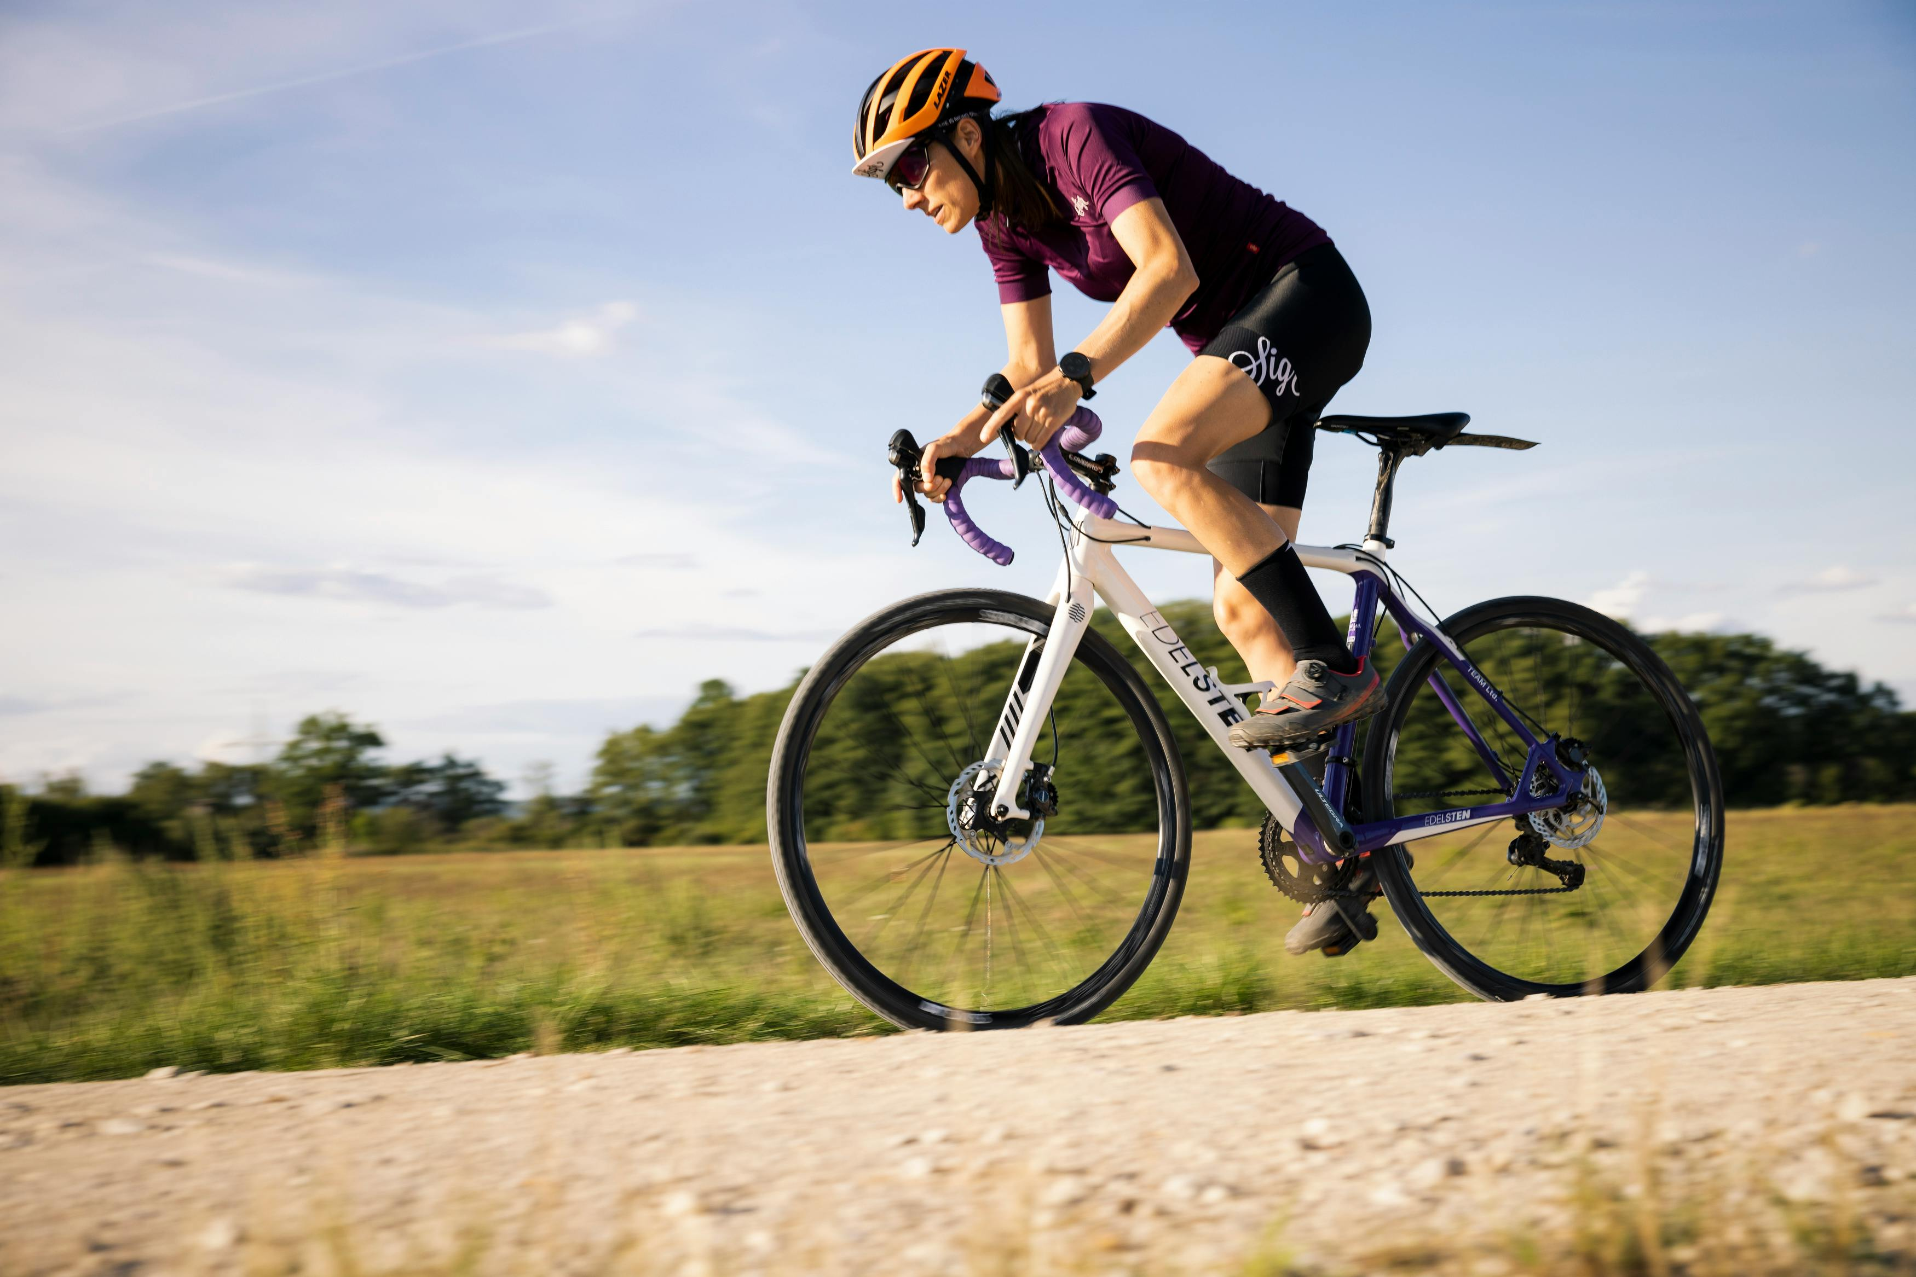
Bicycle_Store Case Study
A research project by
Jui Chakraborty

Slide 2
Case Study
This case study consists of 1 data set.
It has 3 tables:
customer_address
customer_demographic
transactions.

Slide 3
Findings
No. of total customers by gender.
Average distribution of customers by gender , job industry category. customers who own a car and their wealth segment.
Average number of bicycle-related purchases over the past 3 years.
Distribution of customers by state and country. Average property valuation of customers' addresses.
Transaction Insights: Most purchased product brands, product lines.

Slide 4
Objectives
Analyze customer demographics and behavior, identify trends in transactions, and provide actionable recommendations for improving business performance.
Publish the findings based on data analysis.

Slide 5
Important factors to optimize business
Analyzing sales data to optimize product selection, pricing strategies, and inventory management and reducing cost.
Identifying opportunities and entering new market segments based on customer demographics and market trends.
Investing in training programs to enhance employee skills and productivity, ultimately leading to better customer service and satisfaction.
Implementing innovative technologies such as e-commerce platforms, data analytics tools to drive business growth and improve.

Slide 6
Number of total customers gender wise
Male customers purchases bicycle more than female.

Slide 7
Occupational Insights

Slide 8
Occupational Insights
Manager purchases bicycle most in last 3 years on avg.
Where as Clinical Specialist purchases less on avg.
It shedding light on the demographics and professions of bike enthusiasts.
Helps the bicycle store tailor its marketing efforts and product offerings to better target and serve this customer segment.

Slide 9
Gender Trends

Slide 10
Gender Trends
Understanding these gender-specific trends can inform targeted marketing strategies and product promotions, enabling the bicycle store to effectively engage with and cater to its diverse customer base.

Slide 11
Wealth Segmentation

Slide 12
Wealth Segmentation
It shows how purchasing behavior varies across wealth segments.
Understanding these trends can help the bicycle store tailor its marketing strategies and product offerings to effectively target each wealth segment, optimizing sales and customer satisfaction.

Slide 13
Car ownership vs. bike purchases
The customer who hasn’t any car purchases bicycle more on average.
The customer who owns car purchases bicycle less.
unveils differences in purchasing habits between these two groups.

Slide 14
INDUSTRY INSIGHTS

Slide 15
INDUSTRY INSIGHTS
On average Health department is the highest for purchasing bicycles.
While Telecommunications department is the lowest for purchasing bicycles.
And the other departments is almost same for purchasing bicycles in last three years.

Slide 16
Regional Insights

Slide 17
Regional Insights
The state New South Wales and Queensland is same for purchasing bicycle in last three years.
While the state Victoria buys more bicycle.

Slide 18
Wealth and Gender Insights

Slide 19
Wealth and Gender Insights
The charts provides insights into which demographic segments are more likely to engage in bicycle-related spending.
It helps the bicycle store to optimize its marketing efforts and tailor its strategies to target these high-potential customer segments effectively.

Slide 20
Property Valuations & Customer Distribution

Slide 21
Property Valuations & Customer Distribution
By analyzing the average property valuation and the number of existing customers in each state, the query identifies regions with both high property values and a significant customer base.
These insights can help the bicycle store make informed decisions about expanding into new markets with the potential for profitable growth.
New South Wales and Victoria has high property values and the no. of customer is more than the state Queensland.

Slide 22
Product Line Revenue Analysis

Slide 23
Product Line Revenue Analysis
The product Standard’s total revenue is the highest i.e. 34103$.
The product Road’s total revenue is 15123$.
And the product Mountain’s total revenue is 3790$.
This information can help the store's management to make strategic decisions regarding inventory management, marketing efforts, and product development to maximize profits and enhance business performance.

Slide 24
Brand Analysis

Slide 25
Brand Analysis
The top three brands are :- (i) Norco Bicycles (ii) OHM Cycles (iii) Trek bicycles.
It helps the store's management to identify top-performing brands i.e. which brands contribute the most to the store's overall sales revenue.
It can helps to optimize inventory management, and refine marketing strategies to capitalize on popular brands and drive sales growth.

Slide 26
THANK YOU

